Slide 1
Sprocket Central Pty Ltd
Data analytics approach
[Division Name] - [Engagement Manager], [Senior Consultant], [Junior Consultant]

Slide 2


Agenda
Introduction
Data Preparation
Data Exploration
Data Model Development
Results and Interpretation

Slide 3
Introduction
The purpose of this Data Analytics process is to determine future potential customers by creating a predictive data model with current customers’ demographics.

Slide 4
Data Transformation Note: See processed_data worksheet in data_model.xls for more details
All data was cleaned and combined into one table of current customers.
Age of each customer was calculated from their DOB.
Revenue for each customer was generated from their past transaction details.
Attributes of deceased_indicator, address and country were removed as they were deemed irrelevant for the data model.
Categorical values were converted to numerical values to build ML model.
Columns chosen for analysis:
Gender, past_3_years_bike_related_purchases, job_title, job_industry_category, wealth_segment, owns_car, tenure, age, postcode, state property_valuation, revenue

Slide 5
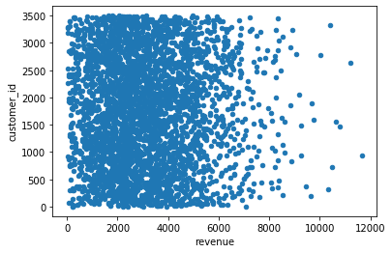
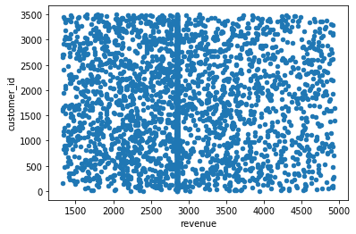
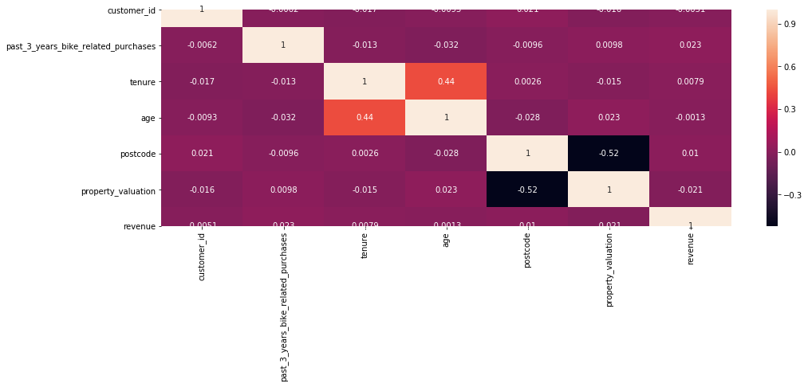
Data Exploration
Outliers (Extreme values) in the revenue column were replaced with the median value.
No significant relationship (correlation) between the attributes which may cause anomalies in the model.

Slide 6

Data Model (Aim: Create a model to predict new customer’s potential revenue and decide which customer to target.)
Divide the current customer into train and test data.
1
Create and Build a regression model on current customer data
2
Apply model on new customer list that predicts the revenue of each customer.
3
If the predicted revenue is greater than the current average revenue, then that customer should be targeted for marketing.
4
Steps
Data Model Metrics:
R squared value: 0.9147 (indicating approximately 91% of the revenue can be explained by the customer attributes chosen.
Average Error: $692 (27%)

Slide 7
Results and Interpretation
500 customers identified to target out of 1000 (50%).
Approximate Average Revenue predicted from potential customers: $3067.
Approximate Total Revenue predicted from potential customers: $1533630.
Most influential attributes, for the model, of customers include:
Gender
State
Wealth Segment
Property Valuation

